Slide 1

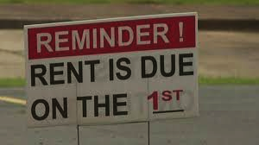
Youth Voices & the Right to Housing During COVID-19

Slide 2





COMMUNITY AGREEMENTS
WHAT’S SAID HERE STAYS HERE, WHAT’S LEARNED HERE LEAVES
Personal stories confidential. Shared learning we take into the world.
MOVE UP, MOVE UP
If you tend to talk a lot, moving up means taking on more listening. If you tend not to, moving up means moving into a role of speaking more.
NO ONE KNOWS EVERYTHING, TOGETHER WE KNOW A LOT
We all get to practice humility, curiosity, respect and generosity.
WE CAN’T BE ARTICULATE ALL THE TIME
Much as might like, we can’t. We want everyone to feel comfortable speaking up, even if we can be as articulate all the time as we’d like.
TAKE RISKS, BE SAFE
Challenging ourselves to grow and learn, but staying present
Notes:
From the good folks at Aorta. Share these, invite additional agreements from the room.

Slide 3
Before we begin…
We Request Your Consent
https://www.surveymonkey.com/r/housingrightsdurham
Notes:
https://www.surveymonkey.com/r/housingrightsdurham
INFORMED CONSENT FORM FOR LISTENING SESSION
As part of the Youth Voices and the Right to Housing During COVID-19 project, you have been invited to participate in this listening session. Please consider this information carefully before deciding whether or not to participate in this research.
Purpose of the research:
Spread awareness of what is happening in Durham with respect to evictions and right to housing during the COVID-19 pandemic;
Capture youth ideas for anti-eviction solutions to influence local decision-makers and share with Durham community.
Contribute to tenant protection/housing rights work - for tenants at risk for and/or impacted by evictions
Who is conducting this research? DataWorks NC, in partnership with Hillside New Tech High School youth researcher, and our partners at Research Action Design (RAD).
What you will do in this research: In this listening session we will ask you questions about your experience, ideas and proposed solutions for secure housing during the pandemic. The session will be facilitated by a youth-researcher, and participation will take approximately 1 hour.
Risks and benefits: There are no anticipated risks associated with participating in this study. Your name and any other identifying information will NOT be shared with anyone. At the end of the project we will develop an infographic of findings which will document your experiences and opinions (anonymously). These materials will be shared with Durham residents. The findings will also be shared by the youth-researcher on a podcast hosted by Data Works in Winter 2020-21. There is no compensation for participating in the listening session.
Confidentiality: Your participation in this study will remain confidential. Responses will be summarized, any quotes will be anonymous!
Participation and withdrawal: Your participation is completely voluntary, and you may withdraw at any time. You may withdraw by informing the youth-researcher that you no longer wish to participate (no questions will be asked).
Agreement: The nature and purpose of this research have been sufficiently explained and I agree to participate in this study. I understand that I am free to withdraw at any time without penalty.

Slide 4
Introductions
Please share:
Your name
1 or 2 things that come to mind when you think about housing justice.
When you’ve finished, tag someone to speak next.

Slide 5
COVID-19 & LOSS OF INCOME

Slide 6
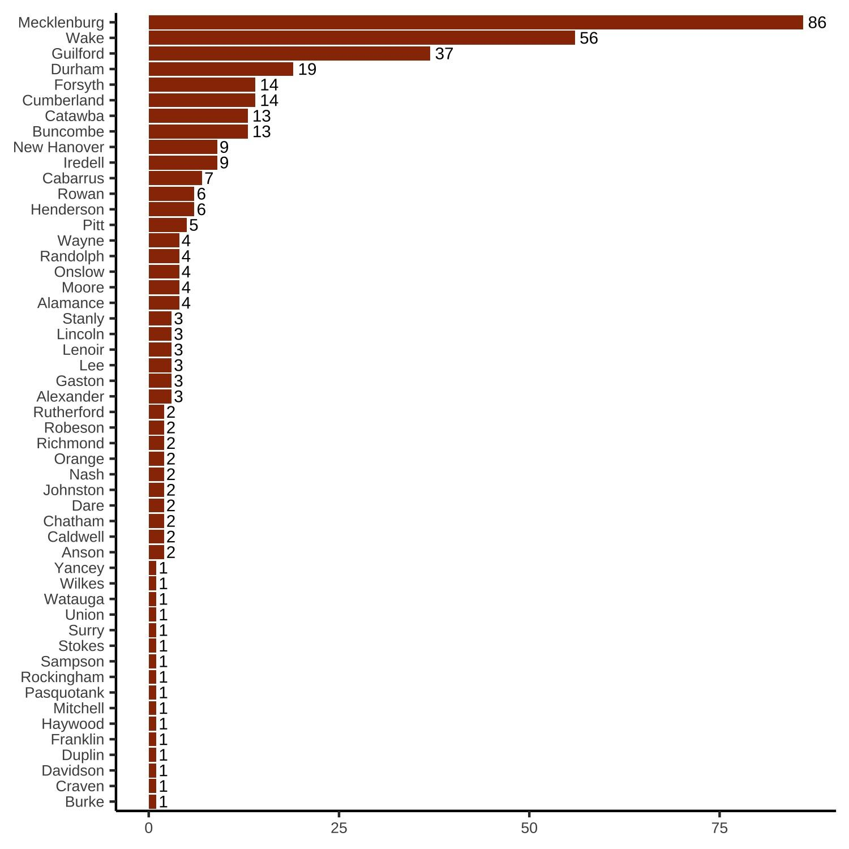
Covid-19 & Job Layoffs in NC
As a result of the COVID-19 pandemic, there have been an increasing number of temporary layoffs and permanent business closings in North Carolina (source: Dept of Commerce, Worker Adjustment and Retraining Notification [WARN] Report).
As of November 5, Durham has had 19 layoff events in 2020.

Slide 7
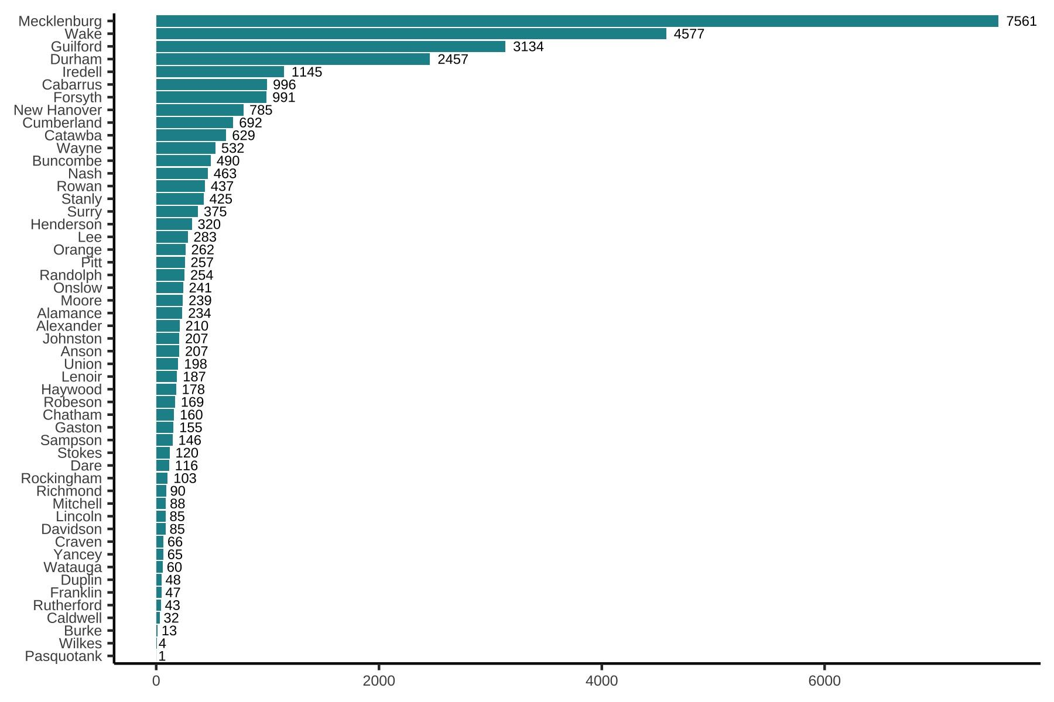
Workers Laid Off by County
As of November 5, 2457 employees have either been laid off temporarily or lost their jobs completely in 2020.
These don’t account for all of the “mom and pop” businesses that have been forced to close.
Notes:
Do you know of a business that has closed this year? Type it in the chat.

Slide 8
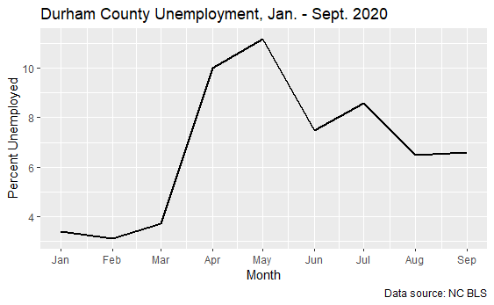
Durham County Unemployment
Another way to look at the effect COVID-19 has had on income is this chart of the unemployment rate, that is, of people who are able to work but are out of work. It peaks at about 11%.

Slide 9

34% of adults report having difficulty covering usual household expenses in North Carolina.
14 % of adults in rental housing report not being caught up on rent in North Carolina.
~ Source: Center for Budget & Policy Priorities, COVID Hardship Watch, data collected Oct 14- Nov 9, 2020
Notes:
Source: https://www.cbpp.org/research/poverty-and-inequality/tracking-the-covid-19-recessions-effects-on-food-housing-and

Slide 10
COVID-19 & LOSS OF HOUSING

Slide 11
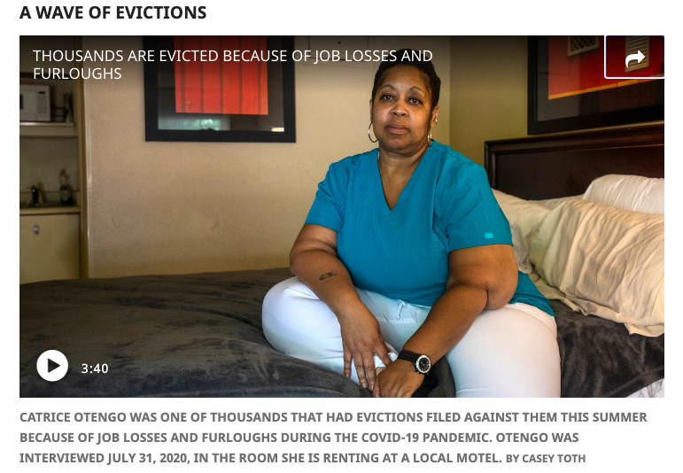
Notes:
Pause: Ask for any reflections on the shared story. What struck you or stood out to you about the video?

Slide 12

Reflections
What struck you or stood out to you about Catrice’s story?
Notes:
Ask participants to share verbally or to share in chat?

Slide 13
What is an Eviction?
Failure to pay rent
Violation of lease
Damage to property
Using it for illegal purpose
Remaining in the unit beyond expiration of the lease term (holdover)
An illegal eviction is when tenants are unlawfully evicted.
An eviction is a legal process when a landlord or someone of authority attempts to remove a person from their home.
Each state determines how they evict tenants. In North Carolina, the reasons a tenant can be removed are:

Slide 14
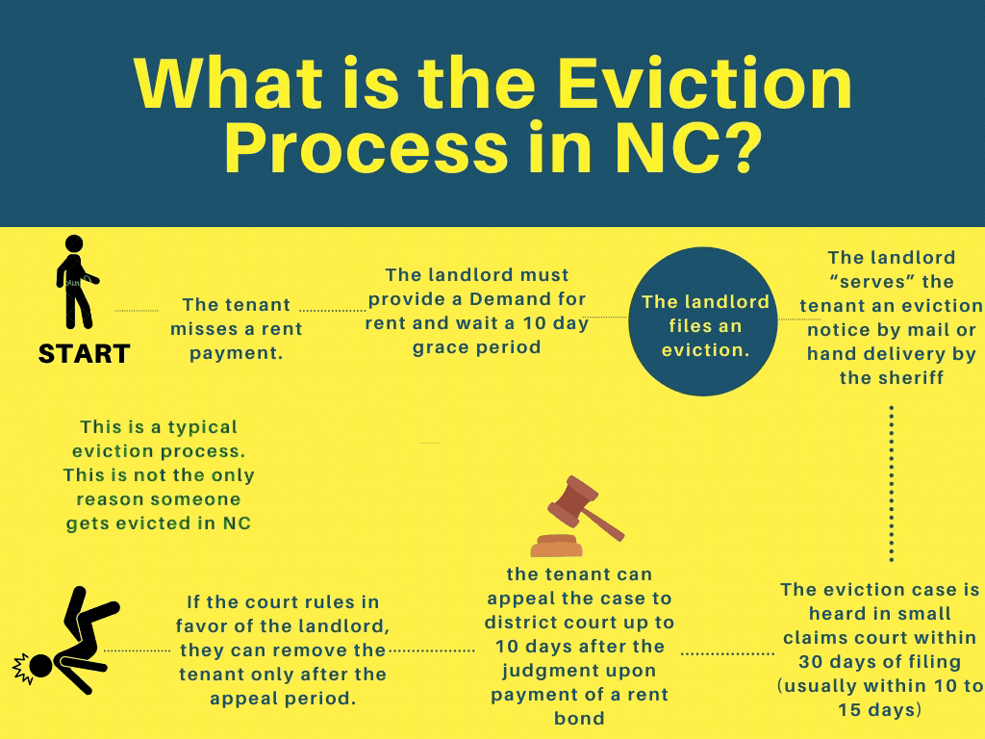

Slide 15
Evictions background
Durham has about 10,000 evictions filed each year
“Evictions” have two parts in NC
  Summary ejectment: When the landlord goes to the court and asks for the tenant to be notified that they have an eviction hearing
  Writ of possession: When the court decides that the tenant is in fact being evicted, the sheriff delivers a notice telling the tenant to leave
  The tenant usually has about a week to leave before they are forcibly removed
The sheriff carries out evictions
We get our data from the sheriff in the form of a spreadsheet containing addresses

Slide 16

As COVID-19 cases soar and thousands remain out of work, it is estimated that by January of 2021, the potential number of eviction filings in North Carolina could reach 240,000.
~ Source: National Council of State Housing Agencies
Notes:
Source: http://pulse.ncpolicywatch.org/2020/08/17/will-covid-19-motivate-us-to-recognize-housing-as-a-human-right/

Slide 17
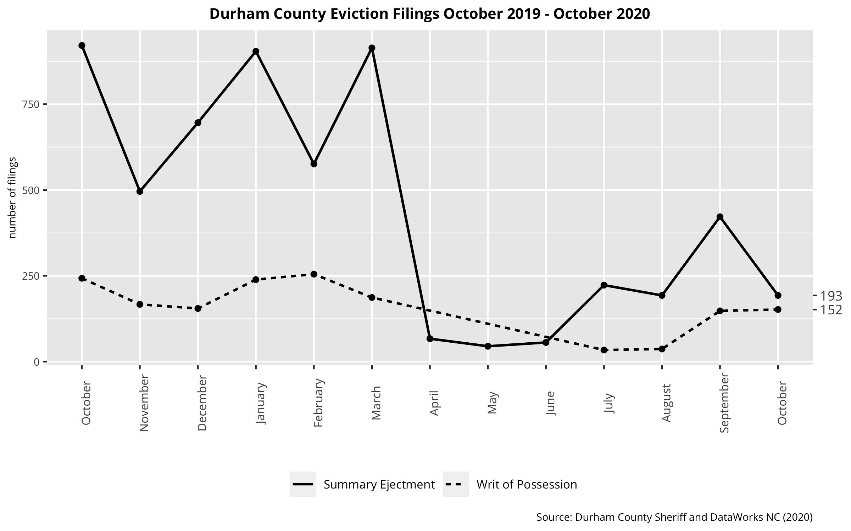
Eviction Filings in Durham
Evictions in Durham were pretty “normal” over the past year… and then the pandemic hit!
State and local regulations prevented many evictions during the summer months as millions lost their jobs, but sadly these measures expired. During July and August, evictions started to return to “normal.”
We’re not sure how many evictions will happen in the next few months as regulations shift a lot, but we expect an increase.

Slide 18
Following an eviction:
Likelihood of experiencing homelessness increases.
Mental & physical health are diminished.
Probability of obtaining employment declines.
Children’s educational development and well-being suffer.
~ Source: National Low Income Housing Coalition, The COVID-19 Eviction Crisis: An Estimated 30-40 Million People in America Are At Risk, Aug 7, 2020
Notes:
Source:https://nlihc.org/sites/default/files/The_Eviction_Crisis_080720.pdf

Slide 19

Discussion
What stands out to you about what the data is telling us?
How does this data compare to what you’re noticing in your community? What is similar/different?
What is surprising or what do you have questions about?
How do you think evictions affect the youth population?
Notes:
Prompts:
Have you noticed if anyone has moved out of your neighborhood during the pandemic?
Do you know anyone who has had to move because of pandemic?
Have you noticed or know anyone who has lost their job?
What barriers do you believe exist with the eviction process? Why?
(Systematic Racism,black mothers are disportionately affected by evictions, corporations jacking up rent pricicies) If no one say this i might or we can add it to slides?
Do you think there’s cruelty in the evictions process? Please elaborate on why there is, or why there is not?
To your knowledge, in the face of our new reality with covid, How Has your community been affected by the housing crisis?
How has your home been a protection to you during COVID-19 and/or how has Covid put the homeless at risk?

Slide 20
COVID-19 INCOME & HOUSING POLICY
RESPONSES & SOLUTIONS

Slide 21
POLICY RESPONSES TO DATE
Income | Housing
CARES Act Federal stimulus check of $1200, $500 per child Federal Unemployment Insurance Relief, $600 Federal Small Business Relief (PPP, EIDL, Debt Relief) NC stimulus check for families w/child $335 starting 12/15 | Federal & state temporary eviction moratoriums Emergency rent/mortgage relief Courts closed temporarily

Slide 22

Potential Solutions?
If you had a magic wand, what would you change, what would you like to see for your community?
Notes:
Prompts:
For example, would you like to change the eviction process? If so, how/what might make it better for renters?
Areas of inquiry for change:
the evictions process?
moratorium policy?
stimulus payment?
Emergency rent (mortgage) relief?
If get stuck, what policy solutions might we share for them to react to, discuss?
E.g. ??

Slide 23
FINAL THOUGHTS
Please share:
ONE new thing you’ve learned or ONE action you’ll take to share what you’ve learned with others.

Slide 24
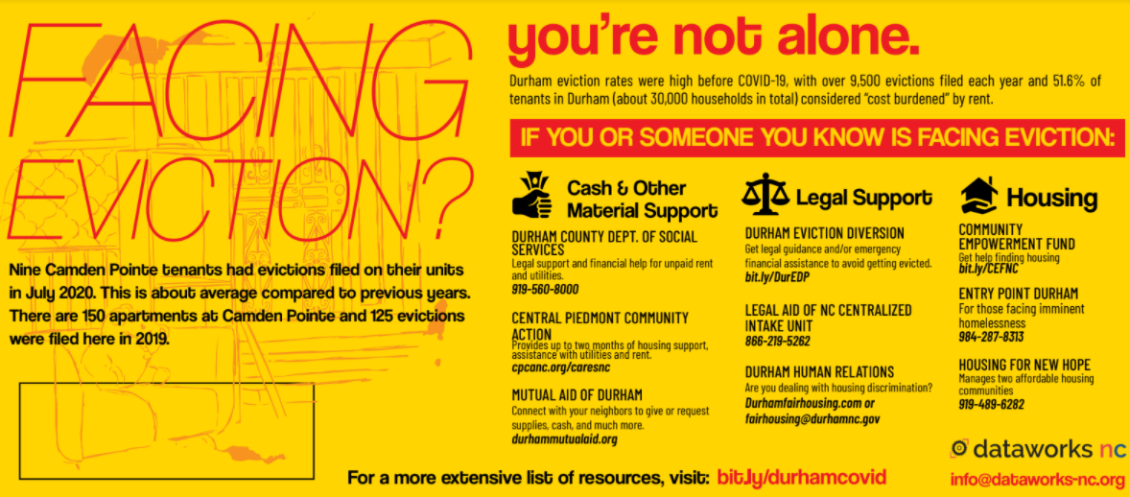
Knowing Your Rights?

Slide 25
Thank You For Coming
If you would like to share your story, you can contact L’Tanya Durante at ltanya@dataworks-nc.org

